Slide 1
Group 5 Final Group SLDC Project
HI 4122 System Analysis and Design
Presenters
Angel Murphy, Julianna Rabin, Jennifer Pham, Jemilla Banner

Slide 2

Agenda
Project Overview
Requirements Gathering and Documentation
System Analysis and Process Improvement
Context Data Flow Diagram
System Acquisition
Technical Feasibility Analysis
Cost-Benefit Analysis
Stakeholder Feedback
Final Recommendation
Next Steps
Conclusion

Slide 3

Project Overview
Project Title: Enhancing Medicare Enrollment for Beneficiaries​
Company: Medicare (CMS)
Objective: Streamline enrollment processes, provide personalized support, and improve operational efficiency​
Target Audience: Elderly beneficiaries and those with certain disabilities​
Purpose:​
Develop a unified system to improve enrollment, education, and support​
Streamline Medicare Advantage payment management​
Scope:​
Design and implement a comprehensive Business Support System (BSS)​
Focus on enrollment, beneficiary support, and payment management​
Goals:​
Improve usability and accessibility for elderly beneficiaries​
Personalize support with tailored resources and tools​
Enhance efficiency through data analytics

Slide 4

Requirements Gathering and Documentation
Streamlined Requirements Gathering
Stakeholder Input: Engaged beneficiaries, healthcare providers, and administrators to collect comprehensive feedback.
Process Analysis: Identified bottlenecks and inefficiencies in current enrollment processes
Priority Requirements: Focused on enhancements to improve accessibility and process efficiency.
Documentation Outcome: Developed a prioritized list of system requirements based on strategic impact and feasibility.
Primary Functional Areas: enrollment, eligibility, plan management, communications, usability, performance, security, scalability
Requirements prioritized based on MoSCoW (Must, Should, Could, Won't)
25 Must Have​
20 Should Have ​
​15 Could Have ​
03 Won't Have

Slide 5

System Analysis and Process Improvement
Current Process Analysis​
Mapped 8-step enrollment process​
Identified bottlenecks in application review and approval​
20% of applications require rework due to incompleteness​
Process Redesign​
Streamlined steps, eliminated redundancies​
Automated validations to reduce errors​
Integrated real-time eligibility checks and error handling​
Projected Improvements​
30% reduction in enrollment cycle time​
25% improvement in first-pass application quality​
Added self-service features:​
Save in-progress applications​
Upload supporting documents​
Access personalized plan comparisons

Slide 6
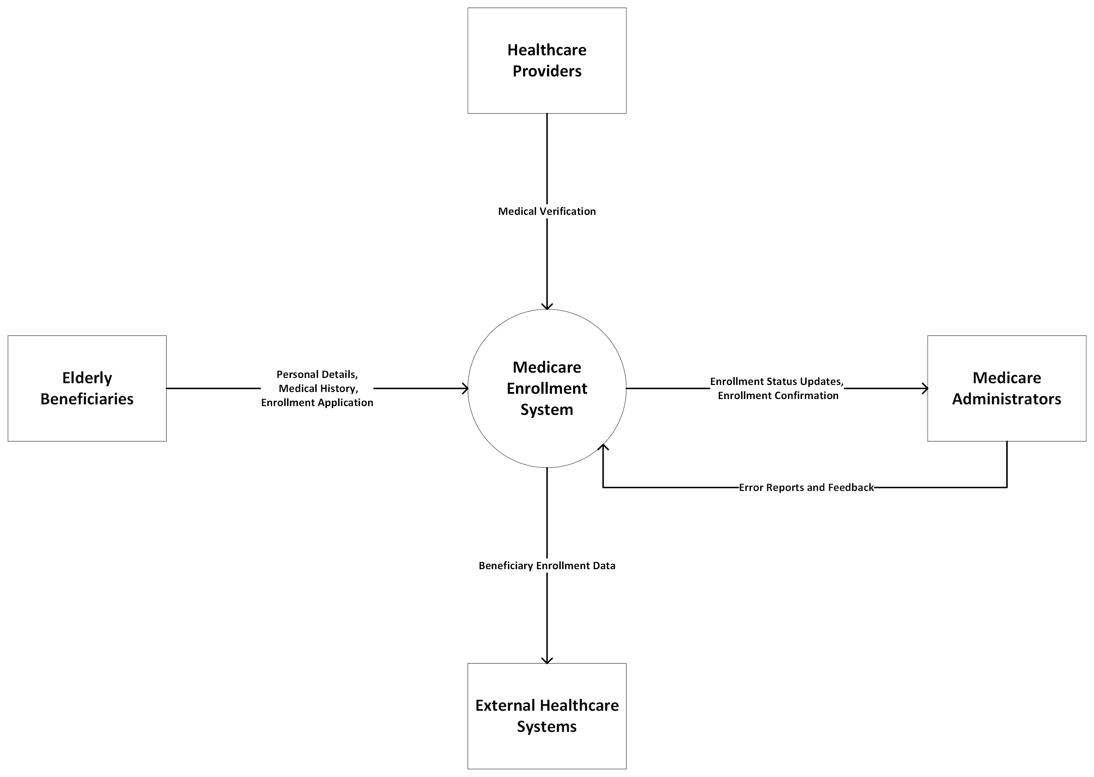
Context Data Flow Diagram

Slide 7
System Acquisition
Option | Pros | Cons
In-house development | Highest level of control and customization, Internal knowledge retention | Longer development timelines, Higher upfront costs, Requires specialized skills
Commercial Off-the-Shelf (COTS) Solution | Proven functionalities, Faster implementation, Predictable costs | Limited customization, Vendor lock-in, Potential integration challenges
Hybrid Approach (In-house + COTS) | Proven functionalities, Faster implementation, Predictable costs | Possible integration complexities, Project management overhead
Recommendation
Hybrid approach Core modules developed in-house (enrollment, support) for maximum flexibility Standard functions sourced via COTS (output management, analytics) for faster returns with the assistance of external experts in specific areas like security and data analytics.

Slide 8
Technical Feasibility Analysis
Overview: Evaluated technical, operational, and economic aspects of MBSS. Focused on IT infrastructure, integration needs, and ROI potential.
Infrastructure: Current systems show aging, lack scalability and interoperability.
Data Challenges: Fragmented sources and inadequate analytics capabilities.
Integration Needs: Requires interfaces with 10+ systems; must support HL7 and FHIR standards.
Risk Mitigation
Data Migration: Extend timelines, conduct mock tests.
Performance: Use elastic cloud architecture for scalability.
Security: Implement enhanced encryption and access controls.
Recommendation
Adopt a Cloud-Based Architecture: Leverage existing Azure investments.
Use Microservices Design: Ensure scalability and phased implementation.

Slide 9
Cost-Benefit Analysis
Project Costs One-Time Implementation Costs Internal labor: $5M (30 FTEs over 18 months) External professional services: $3M Software and infrastructure: $2M Estimated Annual Operating Costs Maintenance and support: $2M (20% of implementation cost) Incremental staffing: $1.5M (10 FTEs) | Quantified Benefits (Over 5 Years) Enrollment Improvement: 15% increase due to enhanced user experience. Cost Reduction: 20% decrease in per-application processing cost through automation. Payment Accuracy: 25% reduction in improper payments via better eligibility checks. Quality Improvements: Improved STAR ratings and quality bonuses from better care coordination. | Financial Projections Net Present Value (NPV): Projected at $25M over 5 years ROI: 250% return on investment Breakeven Point: Achieved in Year 3 Payback Period: 2.5 years Sensitivity Analysis Risk Mitigation: NPV remains positive even with a 20% reduction in benefits.

Slide 10





Stakeholder Feedback
Feedback Collection
Method: Conducted through interviews, surveys, and focus groups.
Beneficiary Focus Groups (n=50)
90% appreciate personalized education and decision support tools.
80% support intuitive self-service options.
Provider Advisory Board (n=15)
Benefits noted: Improved payment transparency and timeliness.
Recommended a phased rollout and comprehensive training.
Medicare Leadership (n=5)
Emphasis on modernizing beneficiary experience and delivering incremental value.
Key Concerns and Mitigations
Complexity & Adoption: User-centric design and proactive change management.
Financial Projections: Conservative estimates and sensitivity analysis.

Slide 11
Final Recommendation
Category | Details
Recommended Strategy | Hybrid model: In-house development & COTS solutions. Agile Methodology for flexibility and stakeholder engagement.
Phased Implementation | Phase 1 (0-6 Months): Enrollment and Eligibility Phase 2 (6-12 Months): Plan Management and Beneficiary Support Phase 3 (12-18 Months): Provider Payment and Analytics
Key Development Activities | JAD Sessions, Iterative Prototyping, Integration and Performance Testing
Critical Success Factors | Executive Sponsorship, Change Management, Risk Management
Projected Outcomes | Enrollment increase: 250,000 by Year 5 Savings: $50M+ Satisfaction Score: From 3.5 to 4.5
System Design Priorities | User-friendly interfaces, Robust data security, Seamless integration

Slide 12

Next Steps Implementing
1. Steering Committee Approval
- Action: Seek project approval for strategic alignment
2. Establish Project Governance
- Action: Formulate a governance structure
3. Schedule Recurring Reviews
- Action: Set-up status reviews and decision checkpoints
4. Kickoff Requirements Gathering Workshops
- Action: Validate priorities, & refine functional designs
5. Assess Change Management Needs
- Action: Identify process and policy impacts to tailor
6. Launch RFP Process
- Action: Initiate RFP for COTS and integration partners
7. Conduct Vendor Evaluations
- Action: Detailed vendor demos and reference checks
8. Baseline Project Metrics
- Action: Establish baseline for schedule, budget, & quality
9. Identify and Assign Resources
- Action: Allocate and assign key project resources adequately
10. Set Up Collaboration Tools
- Action: Implement project collaboration tools & establish
a knowledge repository

Slide 13
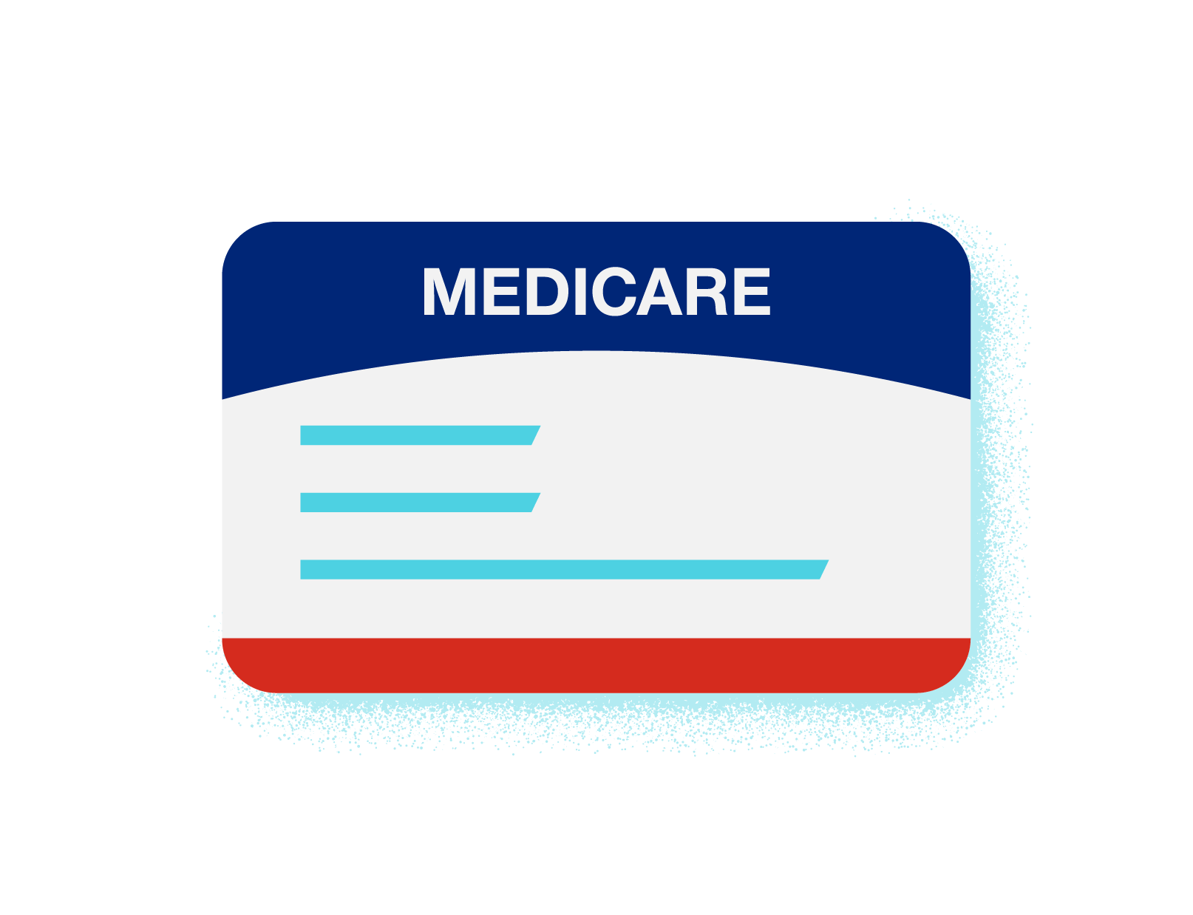
Conclusion Final tips & takeaways
Final Tips
Strong Governance: Ensure robust project oversight through a structured governance model.
Agile Approach: Adopt an Agile methodology to remain flexible and responsive to changes.
Stakeholder Engagement: Maintain continuous engagement with all stakeholders to ensure their needs are met and to foster project support.
Risk Management: Proactively manage risks by anticipating potential issues and planning mitigations.
Key Takeaways
Beneficiary-Centric Design: Prioritize user-friendly design to enhance beneficiary satisfaction and ease of use.
Efficiency Gains: Leverage technology to streamline processes, reducing time and cost while improving service quality.
Data Integrity: Focus on robust data management practices to ensure accuracy and security of beneficiary information.
Sustainable Implementation: Plan for a phased rollout to manage change effectively and ensure system stability.

Slide 14
Thank you
Q&A?

Slide 15
References
https://www.aarp.org/health/medicare-insurance/info-2020/what-is-medicare.html
https://www.singlecare.com/blog/what-is-medicare-part-a/
https://www.seniorliving.org/medicare-medicaid/
https://www.uhc.com/content/dam/uhcdotcom/foundation/blog/blog_primary-author-large-image.png
https://www.uhc.com/content/dam/uhcdotcom/foundation/blog/blog_primary-author-large-image.png

